Slide 1

SQUID MAGNETOMETER
APPLICATION AND DEVICES
Abbas Aljaghbeir -19290837
Nurullah Mertel - 18290219

Slide 2
Contents
Introduction
Superconductivity
Josephson Effect
Magnetic Flux Quantization
How SQUID sensor work basically
Applications and Devices
References

Slide 3
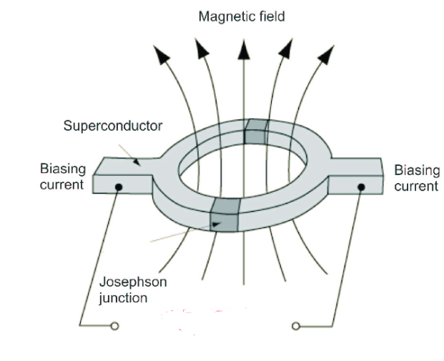
INTRODUCTION
Superconducting
QUantum
Interference
Device
A SQUID is a very sensitive magnetometer used to measure extremely small magnetic fields.

Slide 4
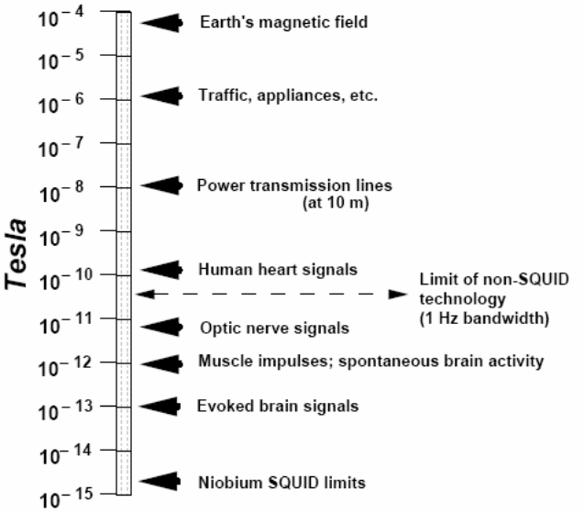
INTRODUCTION
Superconducting
QUantum
Interference
Device
SQUIDs are the most known sensitive sensors for magnetic fluxes.
Threshold for SQUID:10⁻¹⁴ T
Magnetic field of heart:10⁻¹⁰ T
Magnetic field of brain:10⁻¹³ T

Slide 5
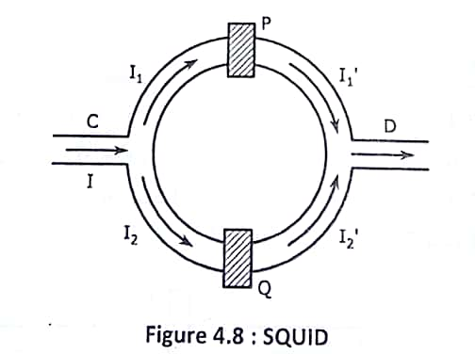
INTRODUCTION
Superconducting
QUantum
Interference
Device
The SQUID sensor consists of two superconductors separated by a barrier known by Josephson junction.

Slide 6
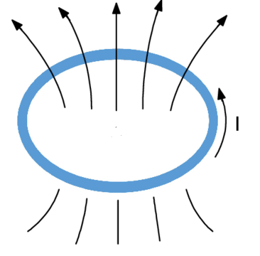
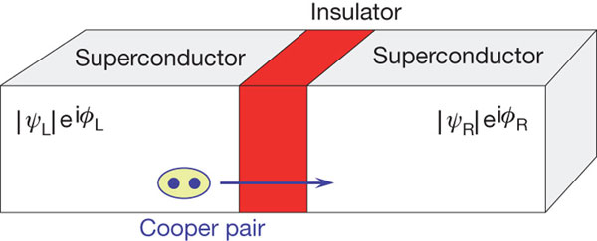
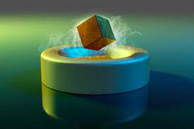


WORkING PRINCIPLE
There are 3 quantum mechanical effects crucial to the operation of a SQUID
Superconductivity
Josephson Effect
Magnetic Flux Quantization
$$ϕ=nϕ_{0}$$
$Φ_{0}=2.07∗{10}^{−15}$T
Superconductivity
Josephson Junction
Flux Quantization

Slide 7
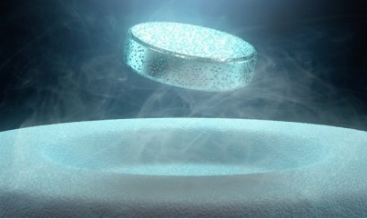
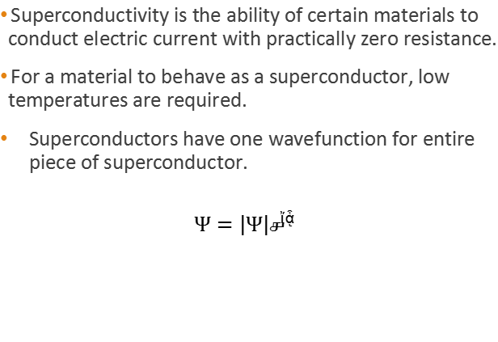

WORkING PRINCIPLE
Superconductivity is the ability of certain materials to conduct electric current with practically zero resistance.
For a material to behave as a superconductor, low temperatures are required.
Superconductors have one wavefunction for entire piece of superconductor.
$$Ψ=\left|Ψ\right|e^{iφ}$$
Superconductor
$$Ψ=\left|Ψ\right|e^{iφ}$$
https://www.sciencealert.com/superconductivity

Slide 8
SUPERCONDUCTIvITY
1911-Discovery of superconductivity by Heike Kamerlingh Onnes. Resistance of mercury cooled by liquid heilum (4.2 K) vanishes.
1957-Bardeen, Cooper, Schrieffer describe superconductivity in BCS theory. Novelty is the Cooper pair: two electrons of opposite sign and momentum bound by electron-phonon interactions.
1962-Brian Josephson predicts the Josephson Junction: two superconductors coupled by an insulating barrier.

Slide 9
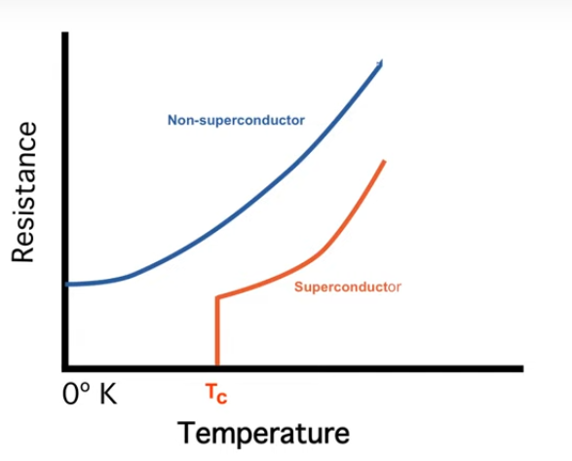
SUPERCONDUCTIvITY
At some critical temperature, the resistance drops to zero. This temperature leads to allow charges to move with perfect efficiency and not have any energy lost due to heat.
According to BCS theory, the atomic lattice vibrations cause the electrons to pair up so they can cross all of the barriers of conductor to resistance.
Cooper pairs are the name given to these electron pairs.
The Cooper pairs have boson characteristics.

Slide 10
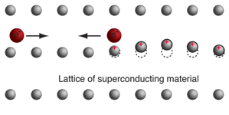
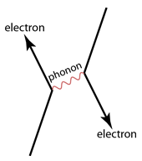
SUPERCONDUCTIVITY
When electron moves through the lattice, it disrupts the positive ions near to it and creating a ripple.
When next electron moves into that region, the electron is attracted to the displacement.
The effect can seen in Feynman diagram where the phonon symbolize the lattice vibration.

Slide 11
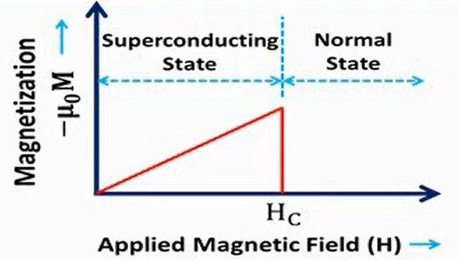
TYPEs of superconductors
TYPE 1 (Soft Superconductors)
As the critical field is reached, entire specimen (sample) enters the normal state.
Resistivity returns
Magnetization vanishes

Slide 12
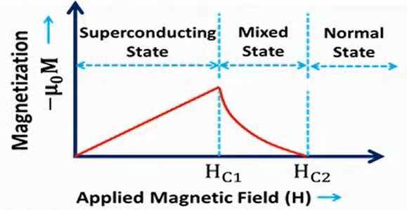
TYPEs of superconductors
TYPE 2 (Hard Superconductors)
The transition from superconducting state to normal state is gradual.
Two critical magnetic fields exists which are Hc1 (lower critical field) and Hc2 (higher critical field).

Slide 13
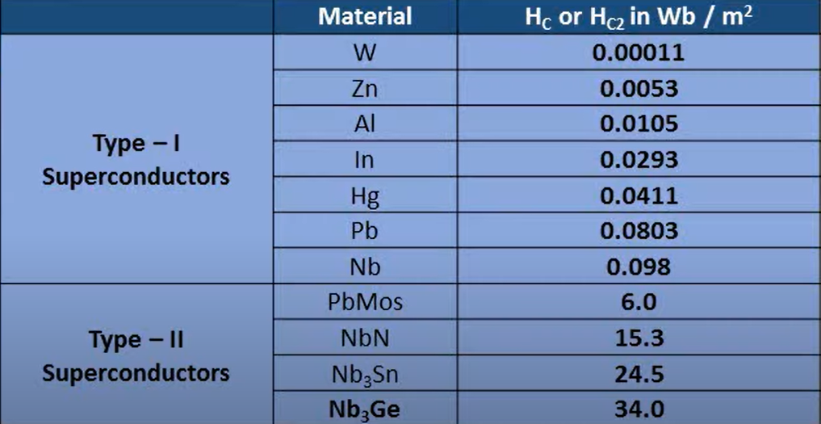
TYPEs of superconductors

Slide 14
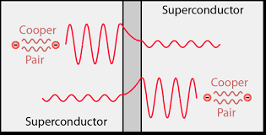
JOSEPHSON EFFECT
The junction showing two superconductors seperated by an insulating layer.
This diagram shows a Cooper pair tunneling into a superconductor through an insulating layer.
Josephson Junction

Slide 15
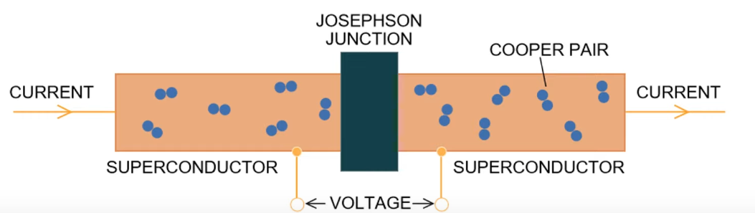
JOSEPHSON EFFECT
The Josephson Junction can have Lithium oxide for insulating layer and Niobium for superconductor.
Critical current depends on:
Size of the junction
Superconducting material
Operating temperature

Slide 16
SUPERCONDUCTIvITY
1911-Discovery of superconductivity by Heike Kamerlingh Onnes. Resistance of mercury cooled by liquid heilum (4.2 K) vanishes.
1957-Bardeen, Cooper, Schrieffer describe superconductivity in BCS theory. Novelty is the Cooper pair: two electrons of opposite sign and momentum bound by electron-phonon interactions.
1962-Brian Josephson predicts the Josephson Junction: two superconductors coupled by an insulating barrier.
1964-Jaklevic, Lambe, Mercerau, Zimmerman and Silver invent DC Squid at Ford’s Dearborn Research lab
1986-Muller and Bednorz discover high temperature superconductor (30 K): ceramic cuprate (copper oxide).
2019-Eremets group at Max Planck Institute demonstrate superconductivity hydride at 250K (-23C).

Slide 17
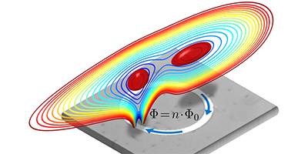
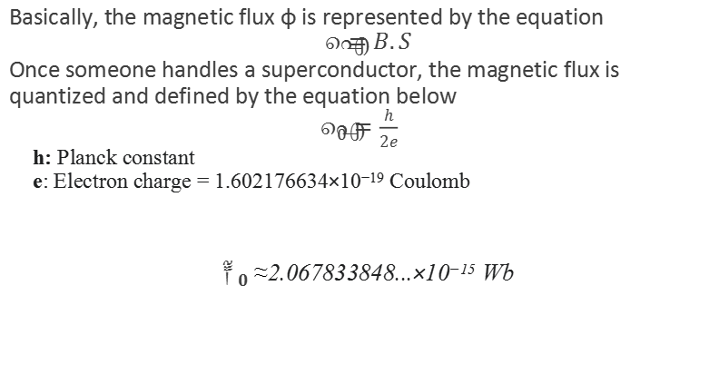
Magnetic flux QUANTIZATION
Basically, the magnetic flux φ is represented by the equation
$$φ=B.S$$
Once someone handles a superconductor, the magnetic flux is quantized and defined by the equation below
$φ_{0}=\frac{h}{2e}$
h: Planck constant
e: Electron charge = 1.602176634×10⁻¹⁹ Coulomb
$φ_{0}$≈2.067833848...×10⁻¹⁵ Wb

Slide 18
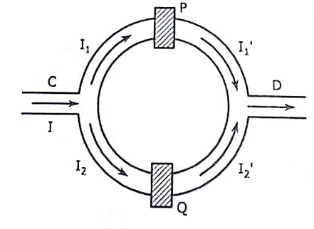


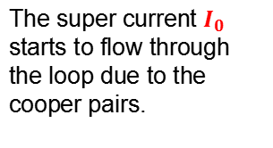

How does SQUID sensor work
The super current $I_{0}$ starts to flow through the loop due to the cooper pairs.
$$I_{0}$$
$Ψ_{2}=\left|Ψ_{2}\right|e_{}^{iφ_{2}}$
$$Ψ_{1}=\left|Ψ_{1}\right|e_{}^{iφ_{1}}$$

Slide 19
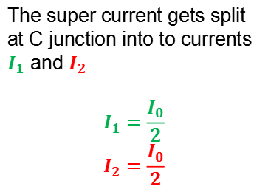


How does SQUID sensor work
$$I_{1}$$
The super current gets split at C junction into to currents $I_{1}$ and $I_{2}$
$$I_{1}=\frac{I_{0}}{2}$$
$$I_{2}=\frac{I_{0}}{2}$$
$$I_{2}$$

Slide 20

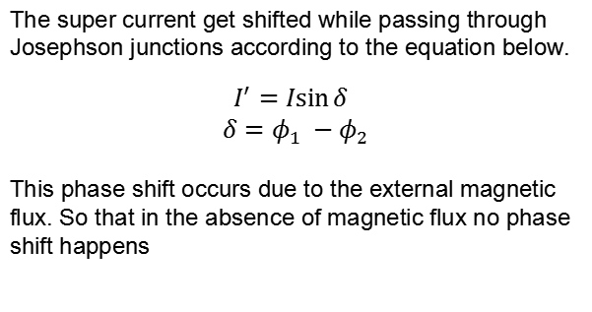
How does SQUID sensor work
The super current get shifted while passing through Josephson junctions according to the equation below.
$$I^{′}=I\sin{δ}$$
$$δ=φ_{1} −φ_{2}$$
This phase shift occurs due to the external magnetic flux. So that in the absence of magnetic flux no phase shift happens
$Ψ_{1}=\left|Ψ_{1}\right|e_{}^{iφ_{1}}$
$Ψ_{2}=\left|Ψ_{2}\right|e_{}^{iφ_{2}}$

Slide 21

How does SQUID sensor work
When an external magnetic flux is applied through the loop, a current denoted by J starts circulating and affects the critical current.
$$φ$$
$Ψ_{1}=\left|Ψ_{1}\right|e_{}^{iφ_{1}}$
$Ψ_{2}=\left|Ψ_{2}\right|e_{}^{iφ_{2}}$

Slide 22
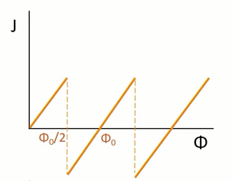


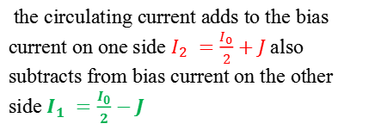

How does SQUID sensor work
$$I_{1}=\frac{I}{2} −J$$
the circulating current adds to the bias current on one side $I_{2} =\frac{I_{0}}{2}+J$also subtracts from bias current on the other side $I_{1} =\frac{I_{0}}{2}−J$
$$φ$$
$Ψ_{1}=\left|Ψ_{1}\right|e_{}^{iφ_{1}}$
$Ψ_{2}=\left|Ψ_{2}\right|e_{}^{iφ_{2}}$
$$I_{2}=\frac{I}{2}+J$$

Slide 23
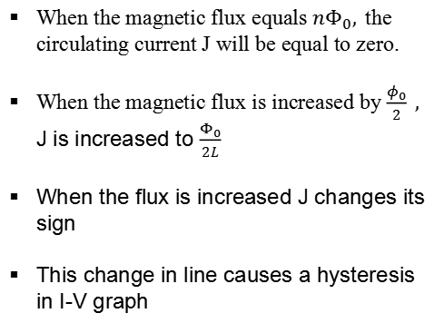

How does SQUID sensor work
When the magnetic flux equals ${nΦ}_{0},$the circulating current J will be equal to zero.
When the magnetic flux is increased by $\frac{φ_{0}}{2} ,$ J is increased to $\frac{Φ_{0}}{2L}$
When the flux is increased J changes its sign
This change in line causes a hysteresis in I-V graph
$$\frac{φ_{0}}{2L }$$

Slide 24
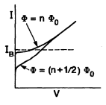
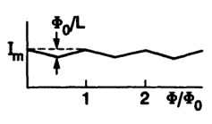
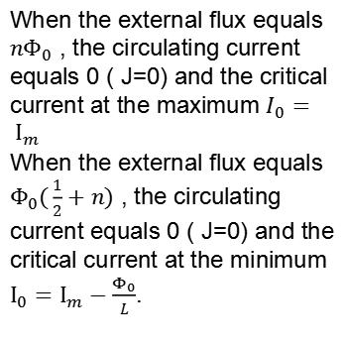
How does SQUID sensor work
When the external flux equals ${nΦ}_{0}$ , the circulating current equals 0 ( J=0) and the critical current at the maximum $I_{0}= Ι_{m}$
When the external flux equals $Φ_{0}(\frac{1}{2}+n)$ , the circulating current equals 0 ( J=0) and the critical current at the minimum $I_{0}=Ι_{m}−\frac{Φ_{0}}{L}$.

Slide 25
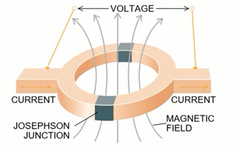
How does SQUID sensor work
Small changes in flux makes small changes in voltage but measurable.
As it’s hard to measure the small changes in flux but small changes in voltage are measurable
SQUIDs are the most sensitive detector that has been created by human being.

Slide 26
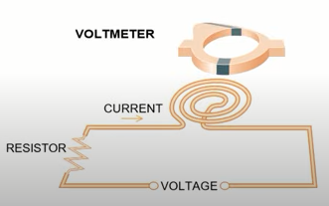
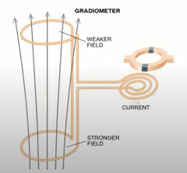
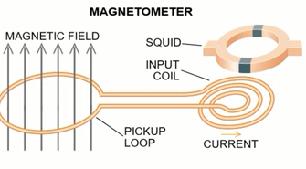
Application of SQUID sensors
By using a different ways to connect the SQUID sensor, SQUID sensor can be used at voltmeter, magnetometer and gradiometer.

Slide 27
Applications
Low Temperature
Magnetic Resonance Imaging
D-Wave Quantum Computers Biological sensing: Cardiac & Brain activities

Slide 28
Applications
Low Temperature
Magnetic Resonance Imaging
D-Wave Quantum Computers Biological sensing: Cardiac & Brain activities
High Temperature
Group in Australia measured electrical connectivity of the ground a few kilometers deep.
They ended up discovering the largest deposit of silver ever found, worth $2 billion Image of George Washington on dollar bill by measuring variations in magnetic fields produced by ink particles.

Slide 29
REFERENCES
https://www.jstor.org/stable/24942801
https://www.youtube.com/watch?v=d_vrhzX3VcE
https://www.youtube.com/watch?v=eOWFuhLlz24&t=107s
https://www.techtarget.com/whatis/definition/superconductivity
http://hyperphysics.phy-astr.gsu.edu/hbase/
https://www.researchgate.net/publication/355756397_SQUID_Magnetometer_-A_Study

